Slide 1

2026 NM-ASR Directions Student-facing Script for Test Administrators
(Note for Test Administrators: Please see the Kite Test Administration Manual for NM-ASR Computer Based Testing Directions and Scripts beginning on page 22.)

Slide 2


Welcome to the New Mexico Assessment of Science Readiness (NM-ASR)! This is session ___.

Slide 3

You are not allowed to have a cell phone or other electronic device during testing.
If you have a cell phone or an electronic device in your possession, turn it off now and raise your hand.
If a cell phone or other electronic device is discovered during testing, it will be confiscated and subject to search.

Slide 4
Do not touch the computers until you are instructed to do so. In this session, you will answer some questions by selecting your responses on the computer screen. You may work out problems on scratch paper.

Slide 5
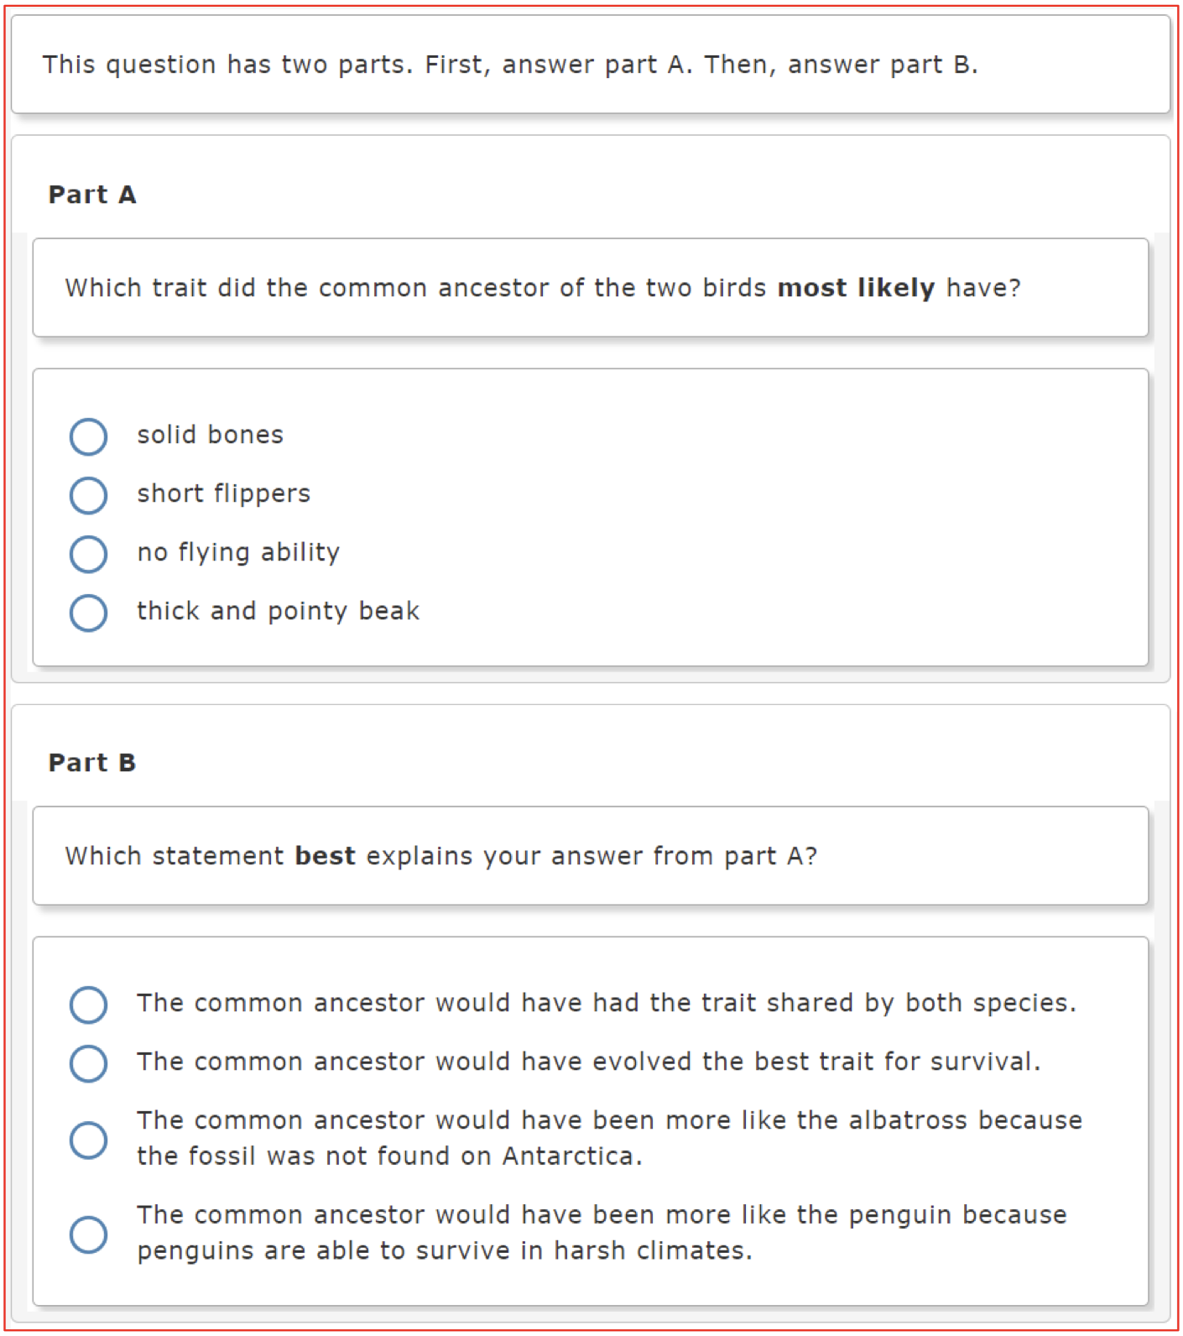
You will answer other questions by writing your answers in the boxes provided on your screen. Some questions have two or more parts. Be sure to answer all parts.

Slide 6
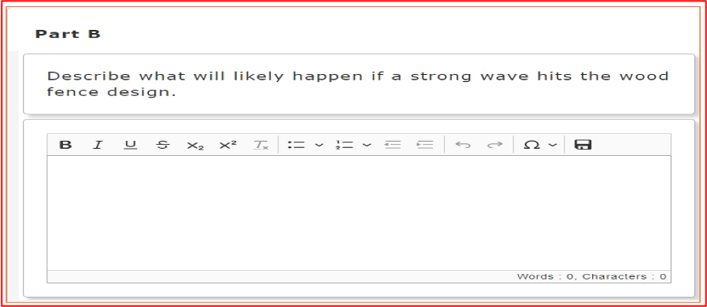
For open-ended questions, show or explain all your work by using numbers, words, or sentences. For questions requiring you to write your answers, type your answers within the boxes provided.
Are there any questions?

Slide 7
Make sure your computer is turned on and your headphones are connected. Do not open any other programs.

Slide 8
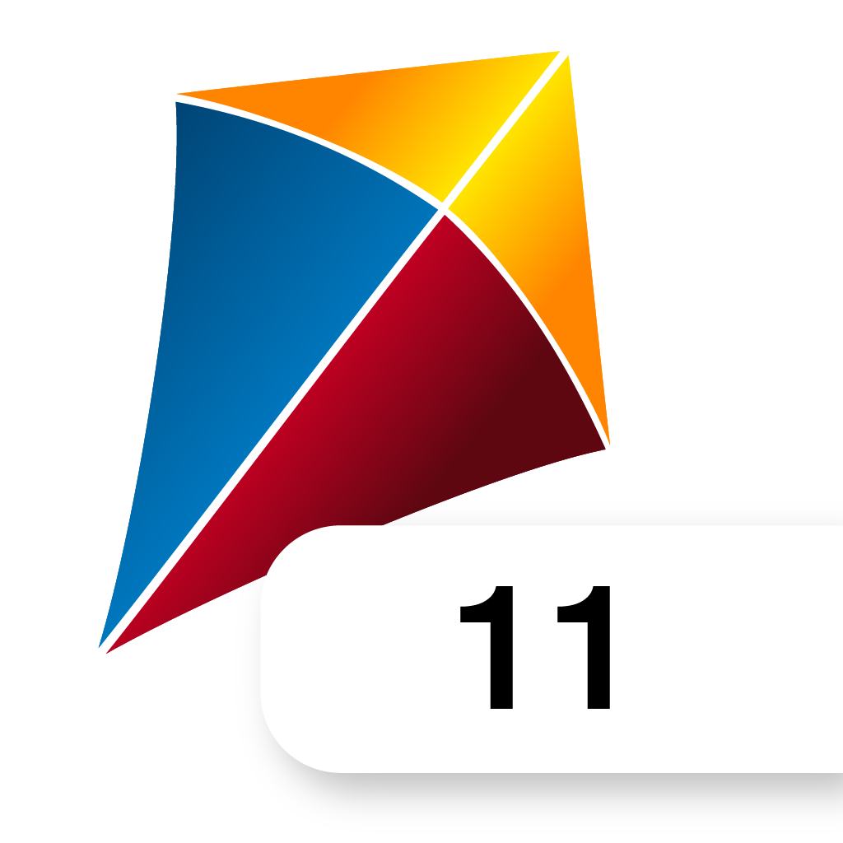
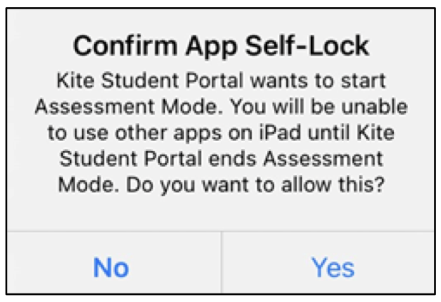
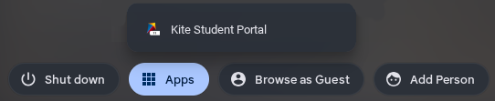
Mac or Windows | Click on the Kite icon on the desktop.
iPad | Tap the Kite icon. Tap Yes when you see the "Confirm App Self-Lock" popup.
Chromebook | Open the Chrome App Launcher from the sign in screen. Open the Kite Student Portal app.

Slide 9
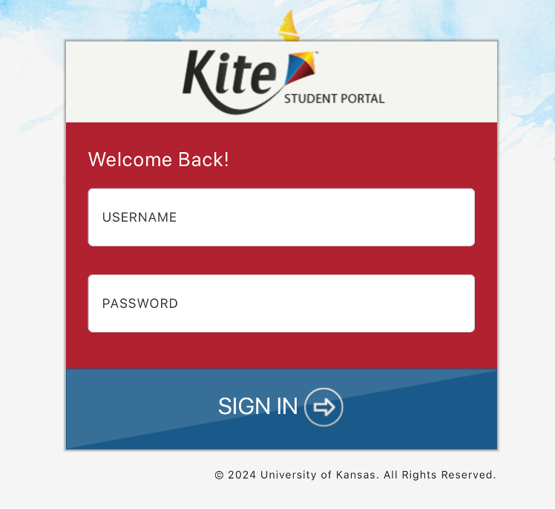
Each of you should see the log-in page on your screen. Raise your hand if you do not see the log-in page.

Slide 10
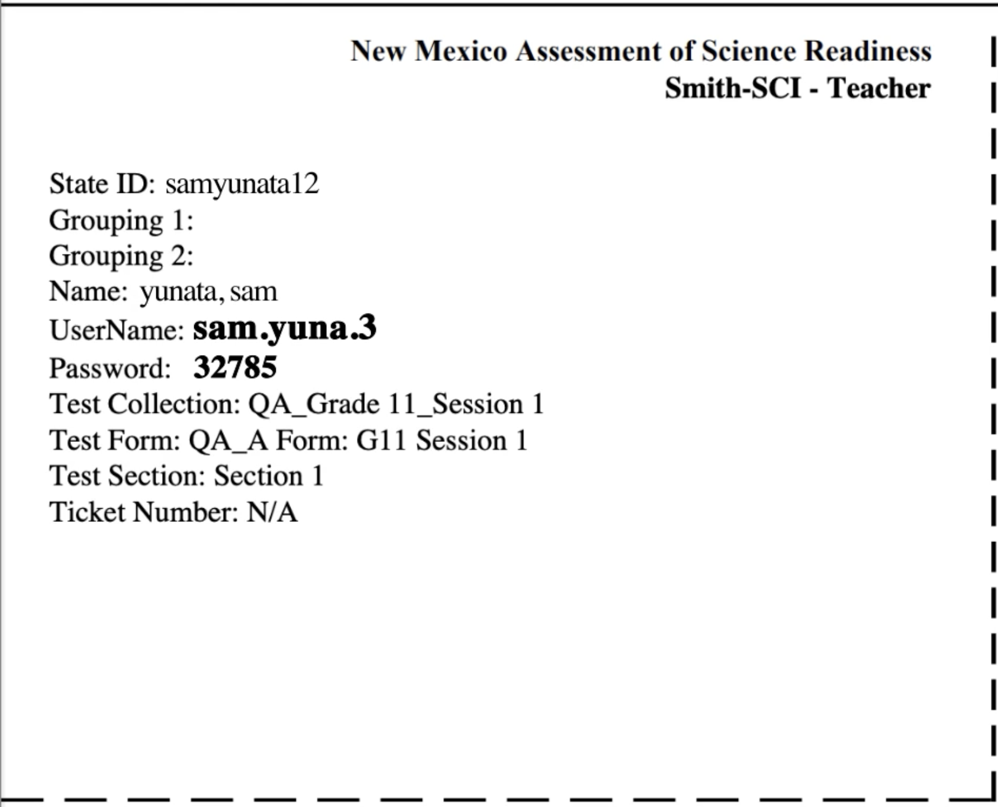
You have been given a test ticket with your name and test login information. Check the ticket to be sure you have your own. If someone else's name is on the ticket, raise your hand.

Slide 11
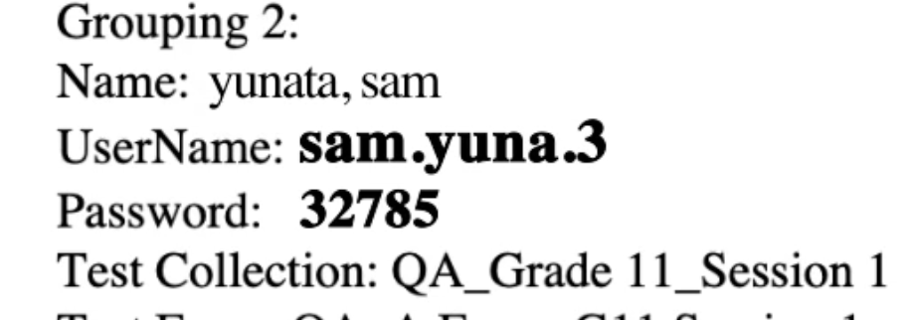
Carefully type the username and password in the log-in screen exactly as it appears on the ticket. Then click Sign In. Keep your login ticket on your desk. It will be collected at the end of this test.
sam.yuna.3
32785

Slide 12
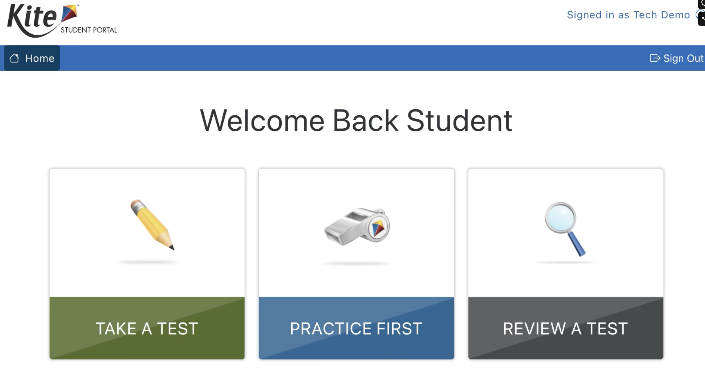
If you have successfully logged in, you will see the words "Welcome Back" followed by your name. If your name does not appear, raise your hand.

Slide 13
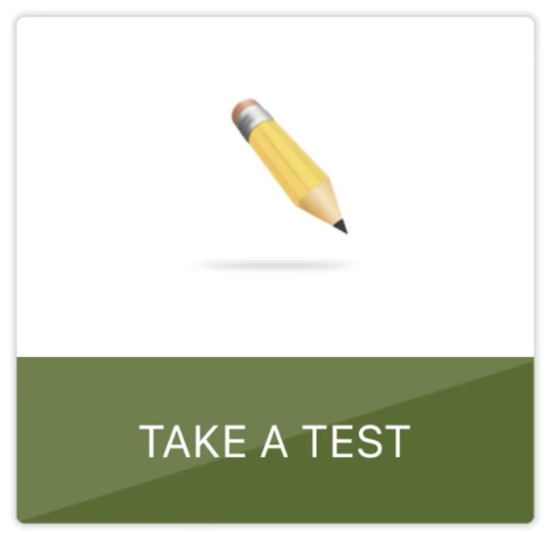
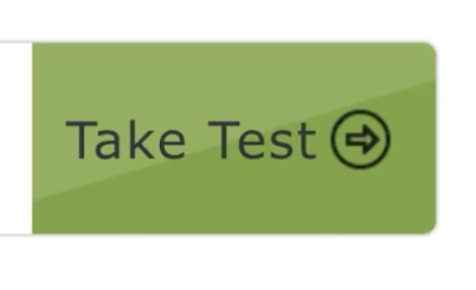
Click the green button that says TAKE A TEST. Then click Take Test.

Slide 14
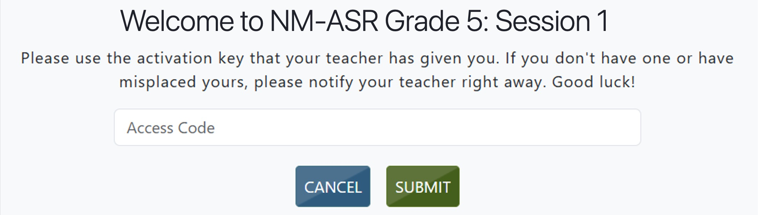
You will now enter a Daily Access Code in the box. The code is _______ . Enter the code now, and then click Submit. Do not go on until you are instructed to do so.

Slide 15
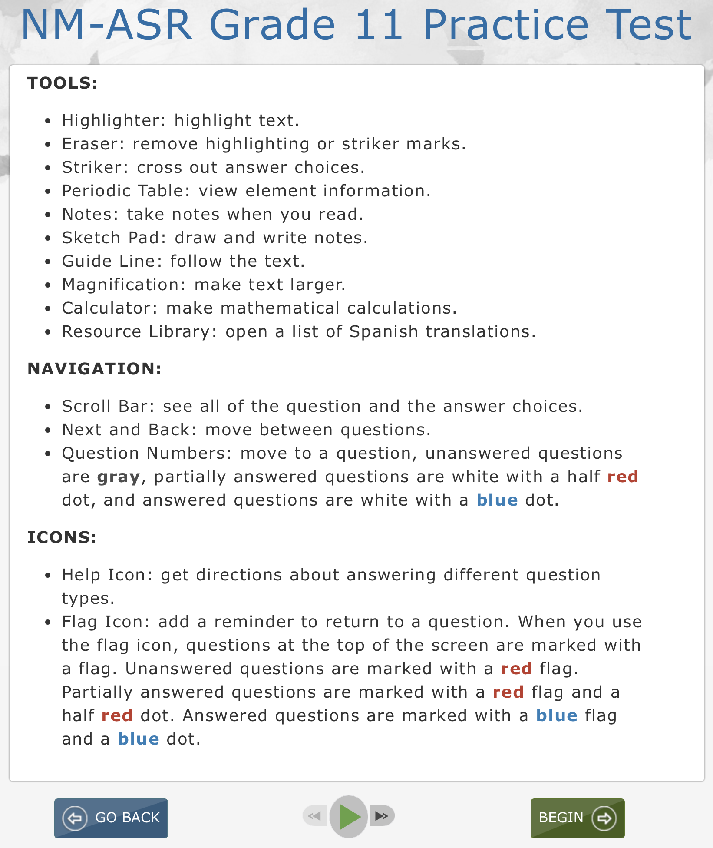
The page you are on should show the directions.
Silently read or listen to the directions. Raise your hand if you have questions. You may return to these directions at any time.
SAMPLE

Slide 16
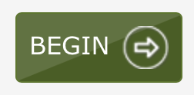
Are there any questions?
Now click the Begin button. The first question in Session ___ should be showing on your screen.

Slide 17
(Note for Test Administrators:
For Session 1: Continue to Slide 18
For Sessions 2 & 3: Go to Slide 30)

Slide 18
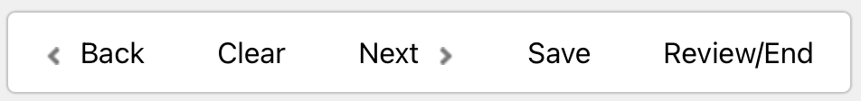
Look at the buttons on the bottom right of the screen.
These are your navigation buttons. Clear will clear your answers for the questions on the page.

Slide 19
Clicking the Next button will take you to the next question. Click the Next button now.

Slide 20
Clicking the Back button will take you to the previous item. Click the Back button now.

Slide 21
Save will exit the test without submitting it. Your answers will be saved. To resume testing, you will need to log in again using your username and password and the Daily Access Code.

Slide 22
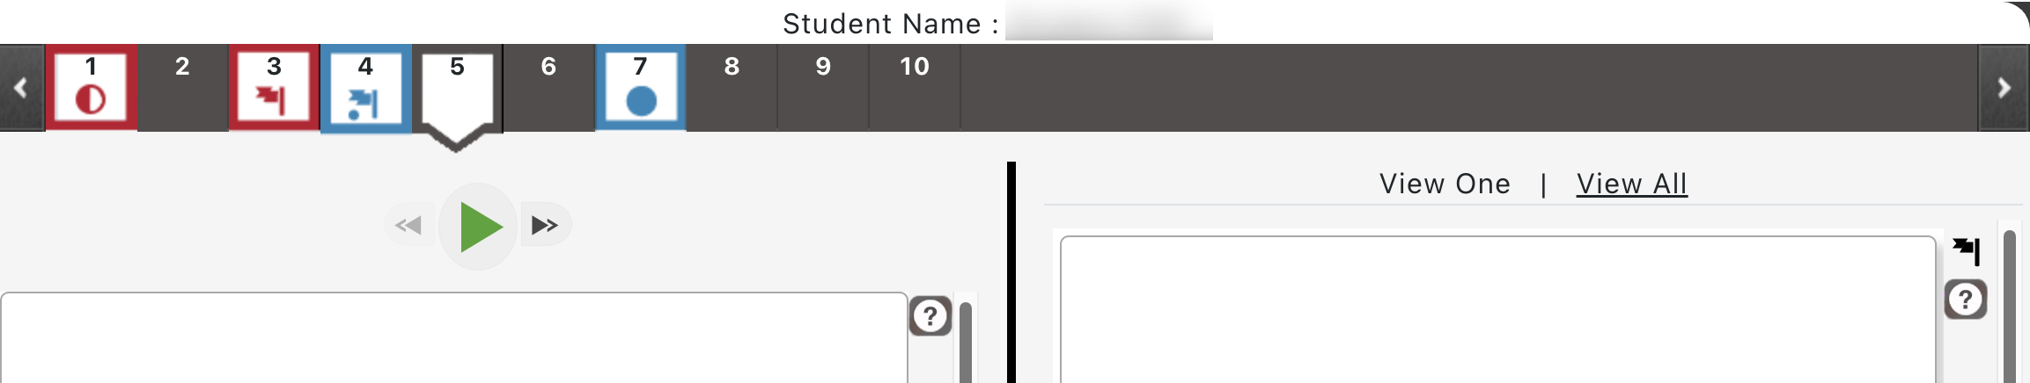
You can mark any item to go back to later by clicking on the flag icon in the upper right of the screen. Click this flag now. The flag now appears in the number box at the top of the screen.
T

Slide 23
Another way to navigate through the test is by using the question navigation at the top of the screen. Answered questions will show a blue dot;

Slide 24
flagged questions have a red flag below the number;

Slide 25
and questions that have not been answered are dark gray. (Notice that you have a flagged question.) Clicking a question number will take you directly to that question on the test.

Slide 26
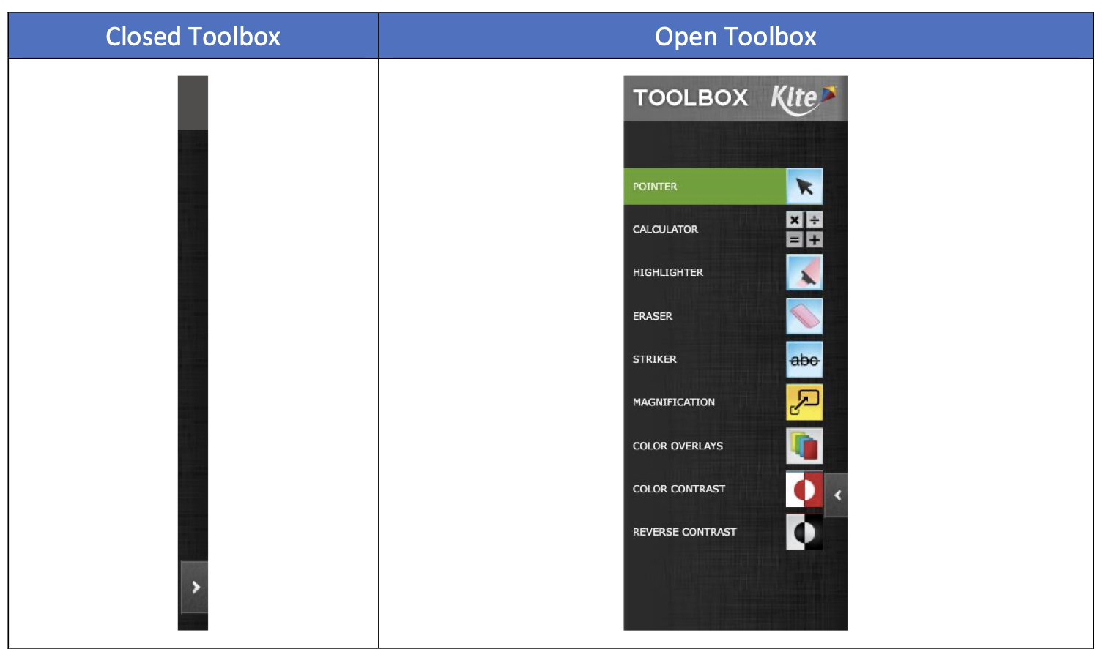
On the left side of the screen is your Toolbox. Click the arrow to show the tools in the Toolbox. There are several tools available to use on this test. Click on the arrow again to hide the tools.

Slide 27
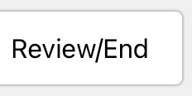
Once you have answered the last question, click Review/End to be taken to the review page.

Slide 28
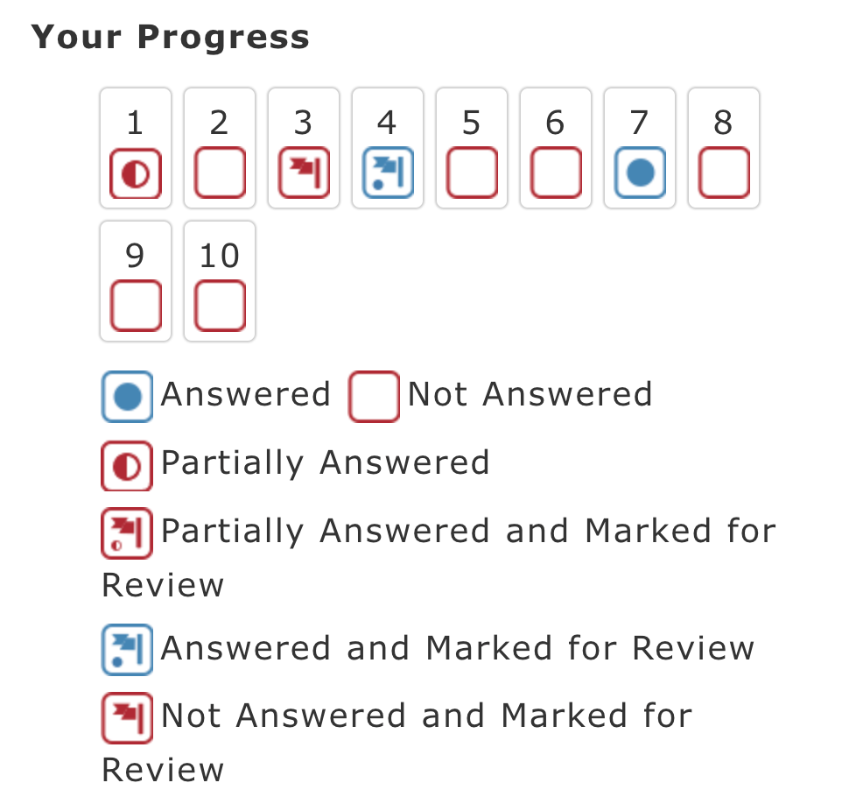
Here you will be able to make sure you have answered every question and review any question that you have flagged. When you have answered all questions, you will click End. You may click any question to return directly to that specific question or click Go Back to go back to the last question in the test.

Slide 29
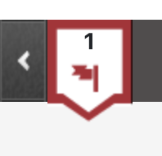
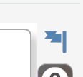
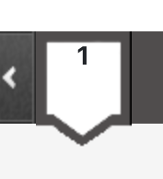
Click on Question 1. Now click the flag to remove it.
Are there any questions about available tools and navigation?

Slide 30
Begin with the first question in Session ___. Work until you reach the end of this session.
You may go back to any of the questions in this session to review your answers. Does everyone understand what to do?

Slide 31
You will have as much time as you need to answer the questions in this session. If you are not sure about the answer to a question, do the best you can.

Slide 32
When you have answered the last question, click the Review/End button. Raise your hand and I will check your screen to make sure that you have completed all the test questions.
Are there any questions?
You may begin.

Slide 33
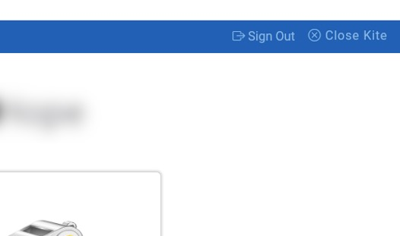
(After Testing:)
If you have not finished, you may have additional time to complete the test. Raise your hand if you need additional time.
Now click Close Kite in the upper-right corner.
This completes Session ___. Please wait quietly at your seat while I collect the scratch paper, pencils, and your login information.

